Slide 1
Retail Data Insights for Strategic Growth
Presented by Renuka Randhir

Slide 2
Agenda
• Data Cleanup Process
• Monthly Revenue Trend (2011)
• Top Countries by Revenue & Quantity
• Top Customers by Revenue
• Product Demand by Country
• Recommendations

Slide 3
Data Cleaning Summary
• Removed invalid transactions (Quantity < 1, UnitPrice < 0)
• Used Power Query in Power BI
• Ensured only valid sales data used

Slide 4
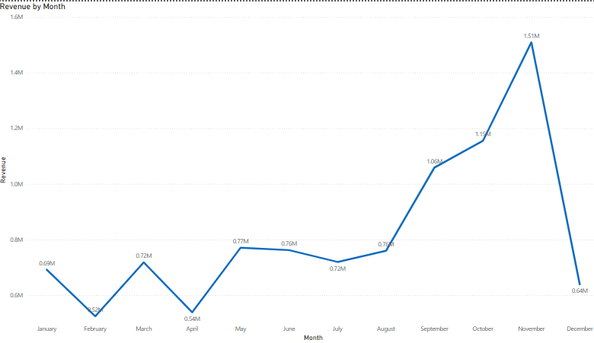
Q1: Monthly Revenue Trend (2011)
• Visual: Line chart (Month vs Revenue)
• Peak in Nov–Dec
• Seasonal demand = Q4 strategy

Slide 5
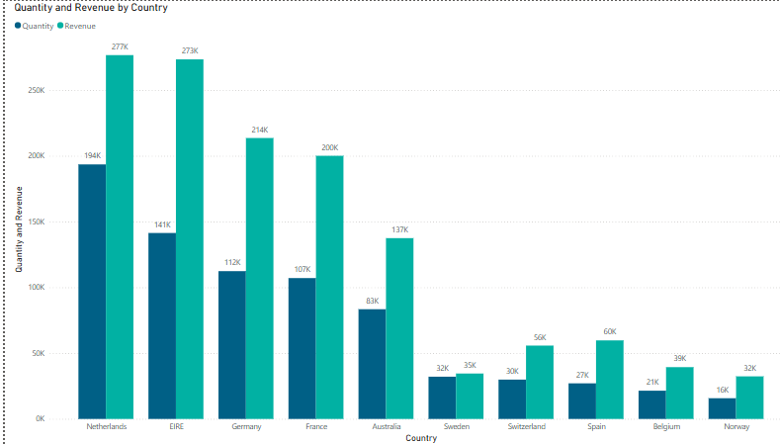
Q2: Top Countries by Revenue & Quantity
• Visual: Stacked bar chart
• Excluded UK
• Top: Netherlands, EIRE, Germany

Slide 6
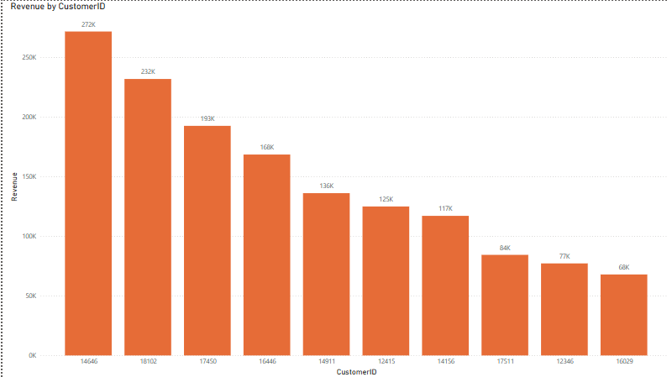
Q3: Top Customers by Revenue
• Visual: Bar chart (Customer ID vs Revenue)
• Focus: Top 10 high-value customers
• Enable retention efforts

Slide 7
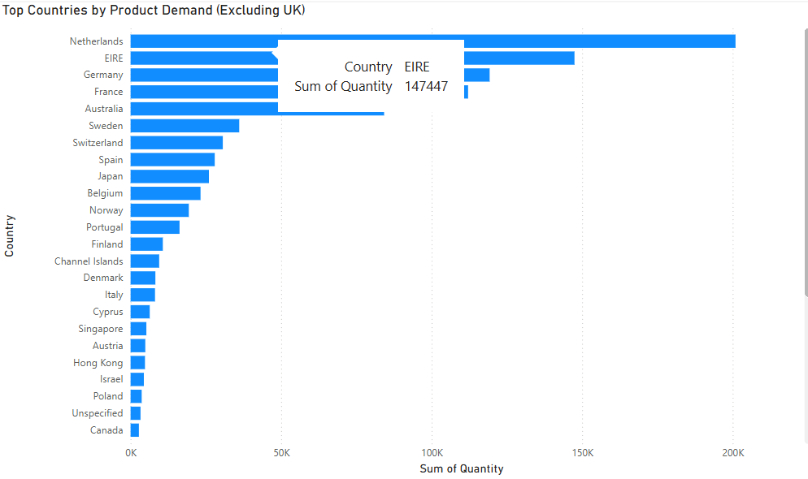
Q4: Product Demand by Country
• Visual: Bar chart (Country vs Quantity)
• Excluded UK
• Top: Netherlands, Germany, France
• High demand = priority markets

Slide 8
Recommendations
• For CEO:
- Plan Q4 marketing & stock
- Expand in high-demand countries
• For CMO:
- Retarget top customers
- Region-based campaigns

Slide 9
Thank You
Thank you for your time.
This analysis provides actionable insights to support strategic decisions.
Renuka Randhir

